Slide 1
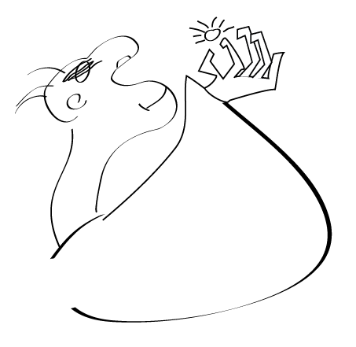
Copyright Basics
AKA – Copyright Basics – how do I protect my work and respect the rights of others?
“I’ve never had an original thought in my life…and there’s tons of people on the internet happy to tell me just that.”
– Shepard Fairey
“Art Is Theft” – Picasso
Textbook: Steal Like an Artist Austin Kleon
Graphic by Lindsey Baker

Slide 2
Disclaimer
The information that follows is true to the best of my knowledge as a layman in regard to the law, with 25 years of experience as a creative professional.
The information was obtained through business school; consultation with legal professionals; and through personal research.
I am not a lawyer and don’t intend for the information herewith to be considered legal advise.
– Lindsey Baker, BFA, MBA

Slide 3
Topics We Will Cover
Copyright Laws and How to Copyright Your work
Trademarks and Service Marks
Fair Use
Licensing
Open Source
Public Domain

Slide 4
Topics We Will Cover
Creative Commons
What To Do If Someone Uses Your Work Without Permission
And, Of Course, How To Steal Like An Artist

Slide 5

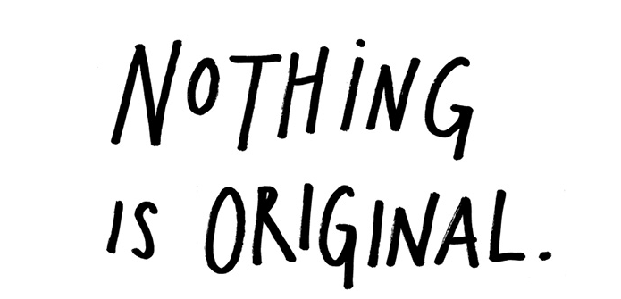
Myth Breaker # 1
Graphic and excerpt by Austin Kleon

Slide 6
Myth Breaker # 1
The writer Jonathan Lethem has said that when people call something “original,” nine out of ten times they just don’t know the references or the original sources involved.
What a good artist understands is that nothing comes from nowhere.
“All creative work builds on what came before. Nothing is completely original.”
– excerpt from: Steal Like An Artist, Austin Kleon

Slide 7
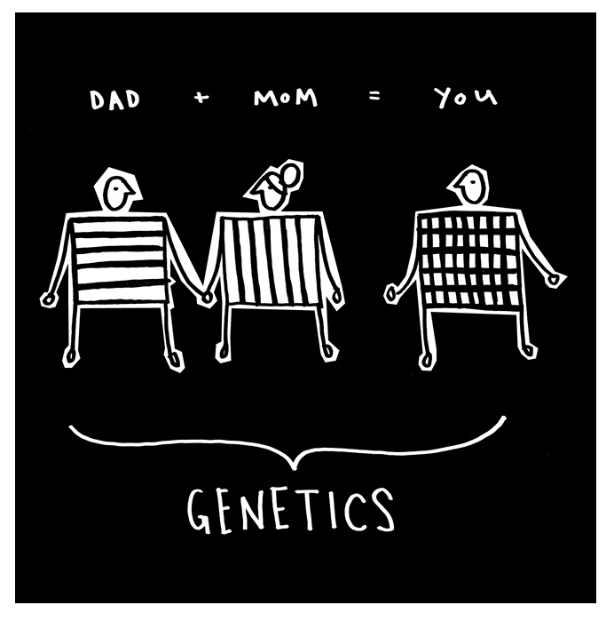
Myth Breaker # 1
Graphic by Austin Kleon
“A good example is genetics. You have a mother and you have a father. You possess features from both of them, but the sum of you is bigger than their parts. You’re a remix of your mom and dad and all of your ancestors.”
– Austin Kleon

Slide 8
What Is A Copyright?
Copyright is a form of protection provided by the laws of the United States (title 17, US Code) to the authors of "original works of authorship.”
Copyright allows you or anyone else to create a creative work and call it yours. 160 countries signed a treaty to observe the copyright laws that are put forth by the US government.

Slide 9

Myth Buster # 2
Copyrighting your work is complicated. WRONG!
You must pay an attorney big bucks. WRONG!
How do you copyright something? Make it.
How long is it protected? Your entire life and seventy years after your death.
Graphic by Austin Kleon

Slide 10
Copyright Basics
If you design a website for someone, under a work for hire contract, they own it.
How long does that copyright last? Ninety five years after it is released or 120 years after it was created

Slide 11
How to copyright something
As soon as you make it tangible, it is copyrighted.
Ideas are not copyrightable, if you have an idea execute it, that protects it.
Not everything is copyrightable. Here is a list of some of the things that are: Websites, Mobile Apps, Videos, Movies, Songs, Recording of songs, Any type of Original Writing, Paintings, Sculptures, Photos, Drawings, Plugins, Software.

Slide 12
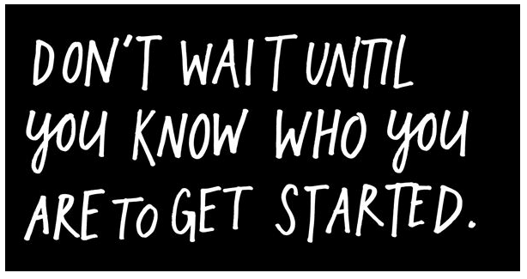
SOOO… start making stuff!
Excerpt and Graphic by Austin Kleon

Slide 13
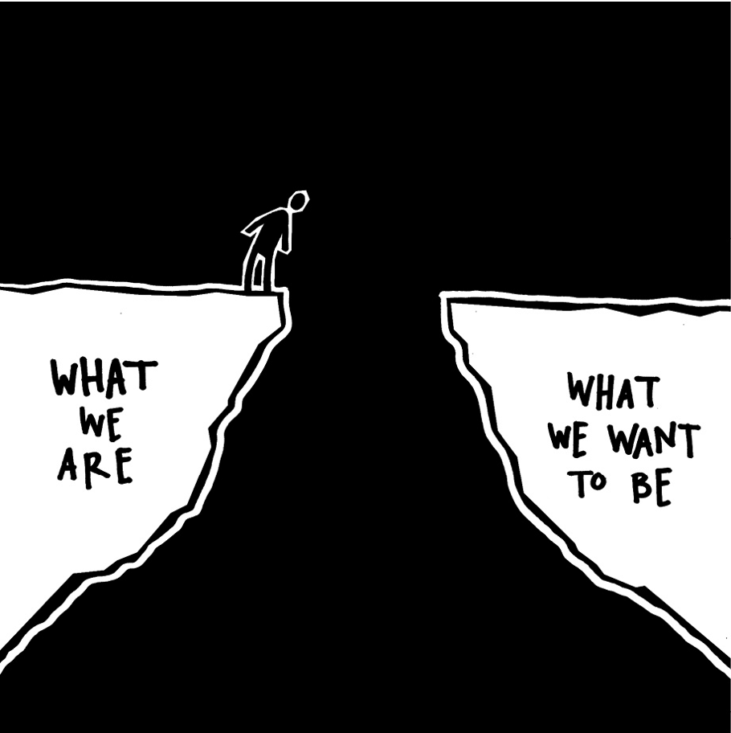
HOW to get from here to there
Excerpt and Graphic by Austin Kleon

Slide 14

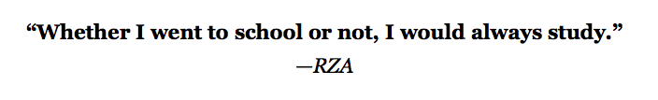
Myth Buster #3 School is never over
“In my experience, it’s in the act of making things and doing our work that we figure out who we are. You’re ready. Start making stuff.”
Excerpt and Graphic by Austin Kleon

Slide 15
How To Write A Copyright Notice
Again, it is not necessary to post copyright notices on your work; the tangible work is the copyright.
Take it easy on the notices. Don’t put it everywhere.
Include: the word copyright, your name and the year. Your name and the year is the most important part.

Slide 16
Copyright Registration
If you decide to register your work; (this is in no way necessary) but it puts your creation in a public database. Register your copyright online at the United States Copyright Office.
If you register your work within 3 months of your creations, this looks great.
You need to decide if this is necessary. It’s cheap and there is no reason not to do it.

Slide 17
Copyright Registration
Fee is $35.00. You can upload your work or mail it in.
If you register something any changes you make afterwards are not included in that initial registration of the copyright.

Slide 18
What is not Copyrightable?
  Titles, slogans, typefaces (you can copyright the font which is the software that makes the typeface work but not the letter style.
  Familiar symbols like the alphabet are not copyrightable
  Also not copyrightable: works created by the government, common knowledge, fashion designs, ingredients and recipes, blank media, domain names

Slide 19
Trademarks
The name Harry Potter is a trademark
Individuals and corporations can trademark or service mark company names.
Trademark is for products, Service mark is for services
Logos, character names, and slogans can be trademarked so so as to identify them as belonging to that person or company.

Slide 20
Fair Use
Fair use is an exception to copyright, while the copyright is still in effect people can still make use of your work.
It has to pass the test of the purpose and the character of the use including whether such use is of a commercial nature or is for non-profit educational purposes.

Slide 21
Fair Use
News Reporting
Educational use
Works of Criticism
Providing information (Google for example can show images of your work without permission)

Slide 22
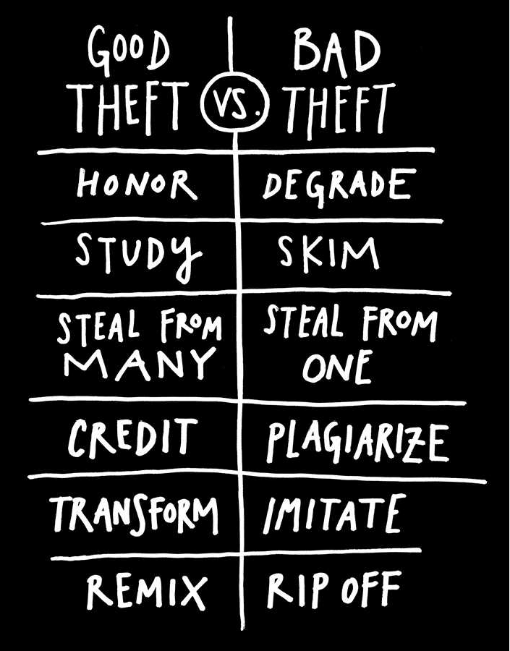
Fair Use
Excerpt and Graphic by Austin Kleon

Slide 23
Character and Purpose of Use
If your not making money off it, it doesn’t necessarily pass the test
Ultimately it’s about why its being used in the first place.
Example: Having a class in a non-profit school watch a clip of a movie to study the speech of the characters using an ancient language is considered fair use.
But the instructor can not show the whole movie

Slide 24
Character and Purpose of Use
“I have stolen all of these moves from all these great players. I just try to do them proud, the guys who came before, because I learned so much from them. It’s all in the name of the game. It’s a lot bigger than me.”
– Kobe Bryant

Slide 25
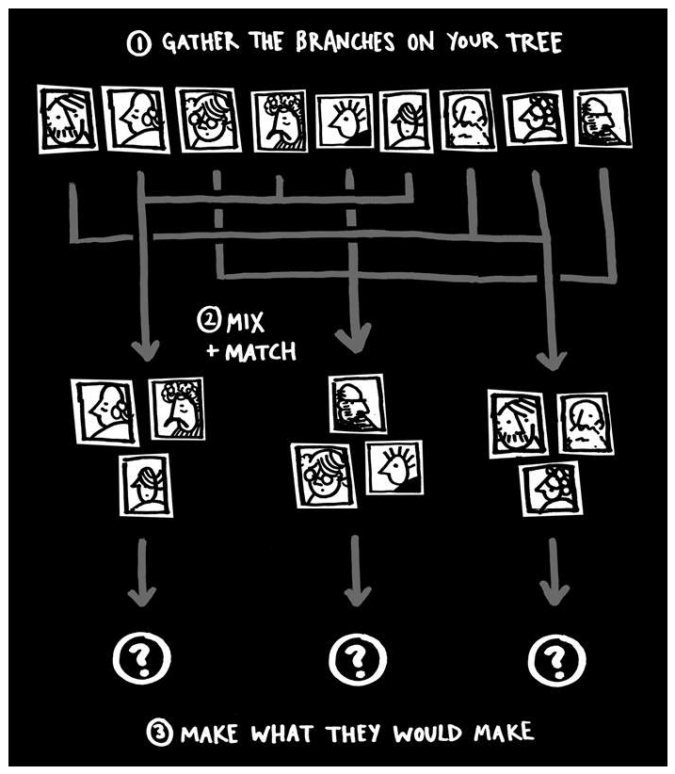
Character and Purpose of Use
Excerpt and Graphic by Austin Kleon

Slide 26
Fair Use wrap up
Definition: the amount and substantiality of the portion used in relation to the copyrighted work as a whole.
It depends on how much of the thing are you using, quoting a paragraph versus copying the whole book.
The effect of the use upon the potential market for or value of the copyrighted work.
It is not fair use if it prevents the owner from selling the copyrighted thing because you gave it away.
The amount you use and if it would hurt the owner’s ability to make money off it.

Slide 27
Fair Use Wrap Up
There is no simple checklist
When in doubt; do the research or consult a lawyer
Fair use is really only a legal defense
General Rule: unless your are specifically creating educational content, don’t use it without licensing it
Should expect at some point for your work to be used for educational use or for critical review

Slide 28
Public Domain
When the copyright is over – work falls into public domain
After enough time lapses, intellectual property can be used.
There are exceptions – as in Wizard of OZ: Dorothy’s Ruby Slippers where a fabrication of the movie producers.
If you are using Beethoven your project, the music is public domain, but the recording you find may be copyrighted so do your homework before you use it.

Slide 29



Go Make Stuff
“The manifesto is this: Draw the art you want to see, start the business you want to run, play the music you want to hear, write the books you want to read, build the products you want to use—do the work you want to see done.”
– Austin Kleon
Take to flight
Graphic by Lindsey Baker

Slide 30
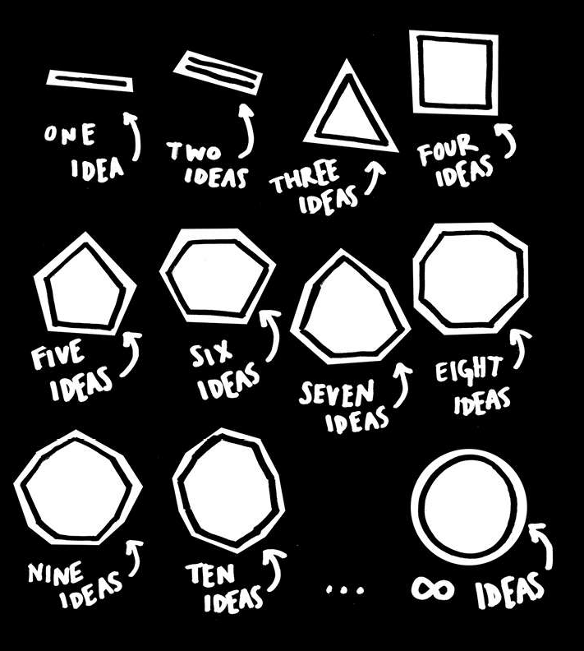
Go make Stuff…then its copyrighted
“When someone is freaking out about someone else stealing
their idea, I always think: what’s the problem? Do you only have one idea?” – Lindsey Baker
Graphic by Austin Kleon

Slide 31
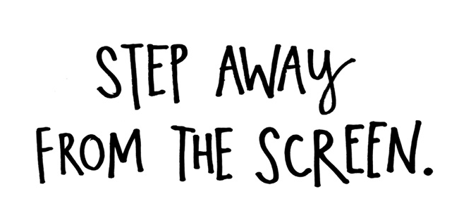
Use Your Hands
“We don’t know where we get our ideas from. What we do know is that we do not get them from our laptops.”
–John Cleese
Excerpt and Graphic by Austin Kleon

Slide 32
Use Your Hands
“You need to find a way to bring your body into your work…our bodies can tell our brains as much as our brains tell our bodies. You know that phrase, “going through the motions”?
That’s what’s so great about creative work: If we just start going through the motions, if we strum a guitar, or shuffle sticky notes around a conference table, or start kneading clay, the motion kick starts our brain into thinking.”
– Austin Kleon

Slide 33
Idle Time Ain’t So Idle
“I have stared long enough at the glowing flat rectangles of computer screens. Let us give more time for doing things in the real world . . . plant a plant, walk the dogs, read a real book, go to the opera.”
— Edward Tufte
“The work you do while you procrastinate is probably the work you should be doing for the rest of your life.”
—Jessica Hische

Slide 34
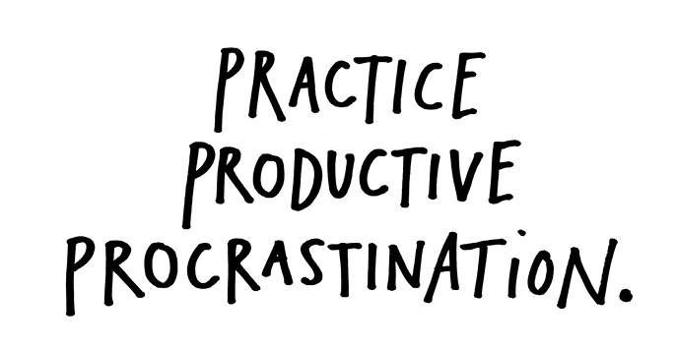
The Three P’s
Quote and Graphic by Austin Kleon

Slide 35
The Three Ps
“… It’s the side projects that really take off. By side projects I mean the stuff that you thought was just messing around. Stuff that’s just play…
That’s when the magic happens. I think it’s good to have a lot of projects going at once... When you get sick of one project, move over to another, and when you’re sick of that one, move back to the project you left. Practice productive procrastination.”
– Austin Kleon

Slide 36
Introduction to Licensing
Licensing is vital if you work with the web
Licensing = Permission
Licensee and Licensor agree to a set of terms.
Someone gives you permission to use something they control.
Things you license: many programs, apps and products you access on the Internet

Slide 37
EULA – end user license agreement
EULA states: “I agree to, not use these products for any purposes prohibited by United States law, including, without limitation, the development, design, manufacture or production of nuclear, missiles, or chemical or biological weapons."
You agree to something like this every time you download legal software.

Slide 38
How to Read a License Agreement:
The following terminology is the basis of all licensing agreements:
What
How Used
How Long
Where

Slide 39
How to Read a License Agreement:
What: Product or Service – what you are actually licensing or using
How Used: Terms – what you agree to
For How Long: Term – relates to the expiration date (how long the lines is in place)
Where: Territory – physical location where the license is good.

Slide 40
Types of Licensing Agreements
Paid Licenses - All software, creative work you pay for on the web, code, apps from iTunes, for example.
Free Licenses - Remember fonts? Even if the font is for free there is still a licensing agreement that accompanies it.
Royalty Free Licenses – there is a one-time charge and there may still be some restrictions on how you can use it.

Slide 41
Open Source
In the case of code; open source code is available to the public.
Free stands for freedom not price.
Can pay for open source. Android is open source. Firefox is open source.
More examples: Gimp, PHP, Ruby and Wordpress
Open source does not mean it is not copyrighted.

Slide 42
General Public License
Under a general public license when you create something with the code. You must pass on the free source.
So what is premium Wordpress theme?
You are really paying for service or support.
Theme that you built is actually based on code that was created by another person.

Slide 43
Creative Commons
Creative Commons licenses are an easy way to share your content freely online.
Let's walk through the different types of licenses and what they mean.

Slide 44
Creative Commons
Combination of Four key Ideas
Attribution – give the creator credit
Non-commercial – can’t use it in “for profit” projects, example: free apps,
No Derivatives – can’t alter it (as in a image)
Share Alike – Has to be shared with the same Creative Commons license

Slide 45
Creative Commons
Let’s consider some combinations
Attribution, non-commercial, Share Alike
Drops the no derivatives requirement,
Asks you to share your project via Creative Commons as well.

Slide 46
Creative Commons
Another combination
Attribution, non-commercial
Has only those two stipulations
Credit to Creator (Attribution)
Not-for-profit use.

Slide 47
Creative Commons
Another combination
Attribution, no derivatives
Drops that non-commercial requirement,
Doesn't allow for altering of the work.

Slide 48
Creative Commons
Another combination
Attribution, Share Alike
Also allows for commercial usage
Requires the sharing via a similar license

Slide 49
Creative Commons
Another combination
Finally, there's just plain attribution
Credit is the only requirement for an attribution license
Otherwise you can use that work however you like

Slide 50
Sharing Your Work
Ask yourself what you wish to do with the work
Sharing your work has advantages, do you want to make money or do you want attention?
www.CSStricks.com makes money on ads.
Be clear about what you want and make it easy to find.
Sharing your work freely is a great way to make a name for yourself. Use Creative Commons.

Slide 51
Good CC Tools For Sharing Your Work
go to www.creativecommons.org and click on licenses>choose a license>asks a couple of simple questions>then the license will update based on your answers…
It will ask you a few questions to describe your creation and then an imbed code will be available to place in your website. It will take people to an ready easy to read page.

Slide 52
But Remember
Once you share your work, you can’t take it back. So make it as restrictive as you wish initially. You can remove restrictions but you can’t add back more.
SO GIVE IT SOME THOUGHT FIRST.

Slide 53
What If Someone Steals Your Work
DMCA stands for Digital Millennium Copyright Act. You can read the whole text of the law online at the Library of Congress.
Here's a sample of what a DMCA notice should look like.

Slide 54
Sending a DMCA Takedown Notice
Be wary of services that ask you to pay them to send DMCA notices for you.
The DMCA is a law.
Sending a DMCA notice yourself is easy and can usually be done online for free.
And don't forget, if you have any major concerns about your specific situation, contact a lawyer.

Slide 55
What To Do First
First step: send the violator an email. What if you can’t find their contact information or they don’t respond?
Second Step: Write a DMCA notification
Lookup the site your saw your work on
Go to: www.copyright.gov
You will find a form and an address to who to send it to

Slide 56
Sending a DMCA Takedown Notice
If you see your work on a social site like You Tube or Tumblr they are required to act on it.
Just Google, for example: Tumblr, DMCA takedown notice and it will take you to a page that tells you what to do.

Slide 57
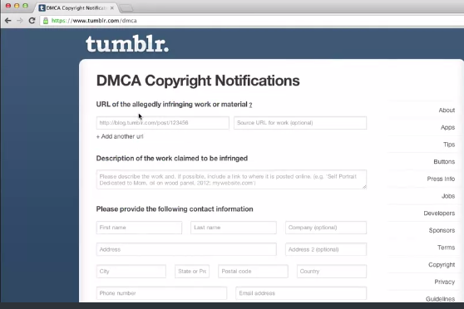
Sending a DMCA Takedown Notice

Slide 58
Sending a DMCA Takedown Notice
Here is what needs to be included in a DMCA notification.
Your name and contact information, so that's your name, your address, your email, your phone number,
Details about the thing you want removed, and be descriptive,
Where your stuff actually is on the site, so that's a URL, again be descriptive as possible. You can't just say Tumblr. You actually have to give them a very specific web address so they can find it in the first place.
See the sample DMCA Takedown Notice in my folder, which includes the verbiage.

Slide 59
Sending a DMCA Takedown Notice
If you have any questions or concerns please contact a lawyer. I am not advising you as to what action to take nor do I guarantee that this is the best legal action to take. Acquiring a lawyer is a personal decision, based on your own personal judgment.
And one last thing: Sending a fake or fraudulent DMCA takedown notice is punishable by law, so only send one if you're truly sure about copyright infringement and are serious about it.

Slide 60
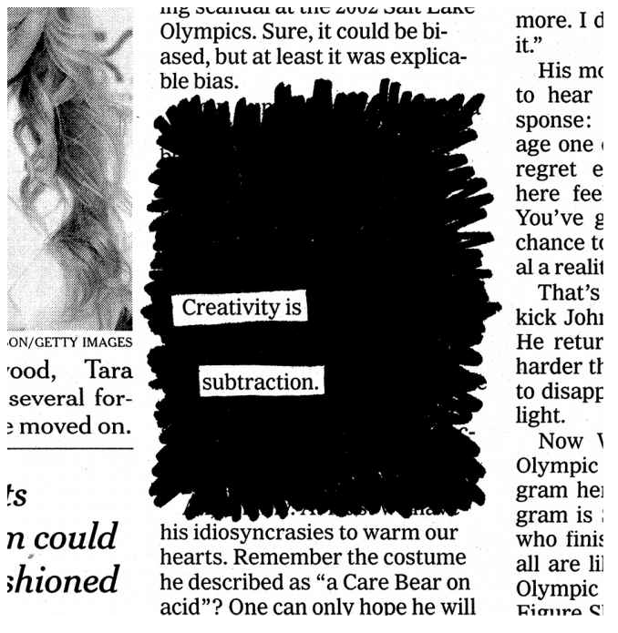

Closing Thoughts…
Excerpt and Graphic by Austin Kleon

Slide 61

What Now?
Talk a walk
Start your swipe file
Go to the library
Buy a notebook and use it
Get yourself a calendar
Excerpt by Austin Kleon

Slide 62
What Now?
Start your logbook
Start a blog
Take a nap
Buy and Read Steal Like An Artist by Austin Kleon
Excerpt by Austin Kleon

Slide 63
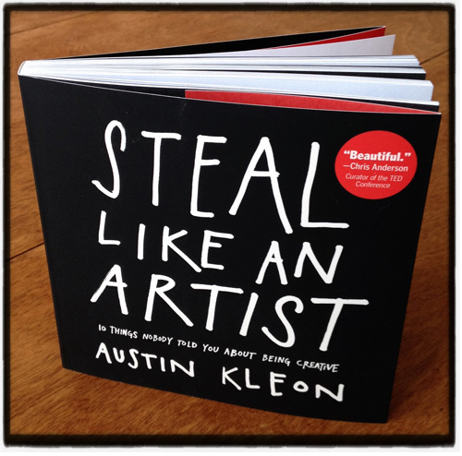
Buy and Read this Book

Slide 64
References and Resources
Austin Kleon (2012-02-28). Steal Like an Artist: 10 Things Nobody Told You About Being Creative (Kindle Locations 607-610). Workman Publishing Company. Kindle Edition.
Treehouselearning.com: Copyrighting course
Lynda.com: Business Principles
United States Copyright Office
www.creativecommons.org

Slide 65

One last word…
(YOURSELF)
Graphic by Lindsey Baker

Slide 66

Questions or Comments:
Contact: lb@synergycreative.com
Graphic by Lindsey Baker

